Slide 1
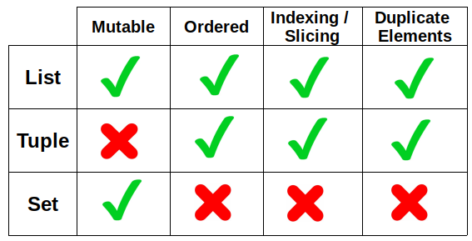
Python Advanced Advanced Concepts using Python lists, tuples, sets & dictionaries
Module - 2
Presentation By
Mohammed Tahir Mirji
MTech CS

Slide 2
CONTENTS
Working with python lists and built-in functions
Construct list in a natural way with list comprehensions.
Understanding of tuples and differences with python list
Deep dive into sets, dictionaries and work with
Assignments
Code Examples Github Link

Slide 3
Working with python lists and built-in functions
Sr.No | Function with Description
1 | cmp(list1, list2)Compares elements of both lists.
2 | len(list)Gives the total length of the list.p>
3 | max(list)Returns item from the list with max value.
4 | min(list)Returns item from the list with min value.
5 | list(seq)Converts a tuple into list.
Let’s code

Slide 4
Working with python lists and its methods
Sr.No | Methods with Description
1 | list.append(obj)Appends object obj to list
2 | list.count(obj)Returns count of how many times obj occurs in list
3 | list.extend(seq)Appends the contents of seq to list
4 | list.index(obj)Returns the lowest index in list that obj appears
5 | list.insert(index, obj)Inserts object obj into list at offset index
6 | list.pop(obj=list[-1])Removes and returns last object or obj from list
7 | list.remove(obj)Removes object obj from list
8 | list.reverse()Reverses objects of list in place
9 | list.sort([func])Sorts objects of list, use compare func if given
Let’s code

Slide 5
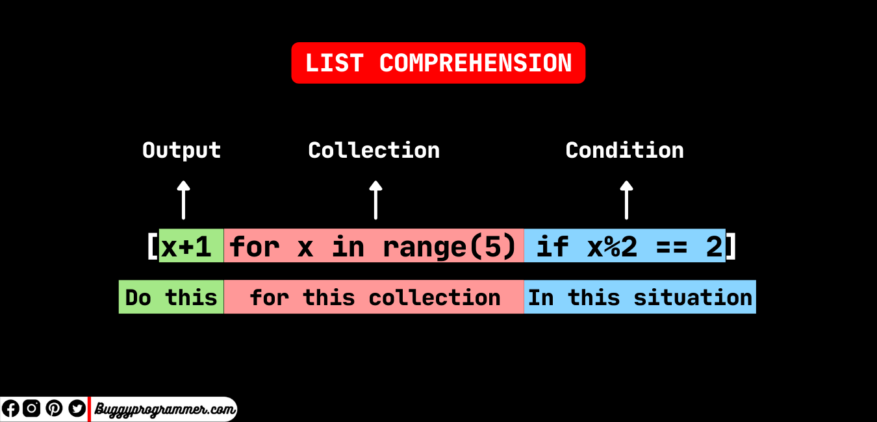
Construct list in a natural way with list comprehensions.
List Comprehension
List comprehension offers a shorter syntax when you want to create a new list based on the values of an existing list.

Slide 6
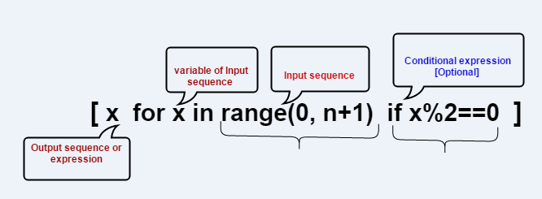
Construct list in a natural way with list comprehensions.

Slide 7
Construct list in a natural way with list comprehensions.
Example:
Based on a list of fruits, you want a new list, containing only the fruits with the letter "a" in the name.
Without list comprehension you will have to write a for statement with a conditional test inside:
A Python list comprehension consists of brackets containing the expression, which is executed for each element along with the for loop to iterate over each element in the Python list.

Slide 8
Construct list in a natural way with list comprehensions.
Syntax:
newlist = [expression for item in iterable if condition == True]
The return value is a new list, leaving the old list unchanged.
The condition is like a filter that only accepts the items that valuate to True.
The iterable can be any iterable object, like a list, tuple, set etc.
The expression is the current item in the iteration, but it is also the outcome, which you can manipulate before it ends up like a list item in the new list.

Slide 9
Construct list in a natural way with list comprehensions.
Code Examples:
Condition
newlist = [x for x in fruits if x != "apple"]
Iterable
newlist = [x for x in range(10)]
newlist = [x for x in range(10) if x < 5]
Expression
newlist = [x.upper() for x in fruits]
newlist = ['hello' for x in fruits]
newlist = [x if x != "banana" else "orange" for x in fruits]

Slide 10
Construct list in a natural way with list comprehensions.
Example 1:
# Using list comprehension to iterate through loop
List = [character for character in [1, 2, 3]]
# Displaying list
print(List)
Example 2:
list = [i for i in range(11) if i % 2 == 0]
print(list)

Slide 11
Construct list in a natural way with list comprehensions.
Example 4:
# Empty list
List = []
# Traditional approach of iterating
for character in ‘Get set go’:
List.append(character)
# Display list
print(List)
Example 3:
matrix = [[j for j in range(3)] for i in range(3)]
print(matrix)

Slide 12
Construct list in a natural way with list comprehensions.
Example 5:
matrix = []
for i in range(3):
# Append an empty sublist inside the list
matrix.append([])
for j in range(5):
matrix[i].append(j)
print(matrix)

Slide 13
Construct list in a natural way with list comprehensions.
Example without list comprehension:
fruits = ["apple", "banana", "cherry", "kiwi", "mango"] newlist = [] for x in fruits: if "a" in x: newlist.append(x) print(newlist)
Example with list comprehension:
fruits = ["apple", "banana", "cherry", "kiwi", "mango"] newlist = [x for x in fruits if "a" in x] print(newlist)

Slide 14
Understanding of tuples and differences with python list
When choosing a collection type, it is useful to understand the properties of that type. Choosing the right type for a particular data set could mean retention of meaning, and, it could mean an increase in efficiency or security.

Slide 15
Understanding of tuples and differences with python list
A Tuple is also a sequence data type that can contain elements of different data types, but these are immutable in nature. In other words, a tuple is a collection of Python objects separated by commas. The tuple is faster than the List because of static in nature.
# Creating a Tuple
Tuple1 = (5, 'Welcome', 7, ‘Students’)
print(Tuple1)
List1=[1,2,’Hello’]
print(List1)

Slide 16
Understanding of tuples and differences with python list
SR.NO. | LIST | TUPLE
1 | Lists are mutable | Tuples are immutable
2 | The implication of iterations is Time-consuming | The implication of iterations is comparatively Faster
3 | The list is better for performing operations, such as insertion and deletion. | Tuple data type is appropriate for accessing the elements
4 | Lists consume more memory | Tuple consumes less memory as compared to the list
5 | Lists have several built-in methods | Tuple does not have many built-in methods.
6 | The unexpected changes and errors are more likely to occur | In tuple, it is hard to take place.

Slide 17
Understanding of tuples and differences with python list
Difference in memory usage:
import sys
a_list = list()
a_tuple = tuple()
a_list = [1,2,3,4,5]
a_tuple = (1,2,3,4,5)
print(sys.getsizeof(a_list),"Bytes")
print(sys.getsizeof(a_tuple),"Bytes")

Slide 18
Conclusion of tuples and differences with python list
A list has a variable size while a tuple has a fixed size. Operations on tuples can be executed faster compared to operations on lists.

Slide 19
Deep dive into sets, dictionaries and work with

Slide 20
Assignments

Slide 21
Code for the presentation can be found here
Refer Readme.md of github repository for list of assignments:
https://github.com/tahirmirji/ai_with_python_keonics

Slide 22
Thank You

